Slide 1
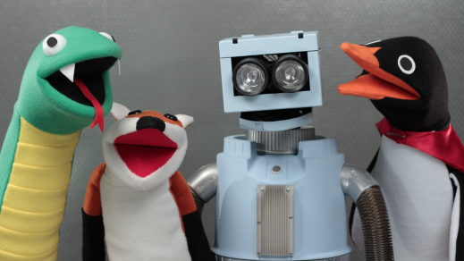
Hello Son Shine Club

Slide 2
Introduction Everything we have was given to us by God. How often do we remember to say” Thank You”

Slide 3
Light the candles

Slide 4
Matthew 22:15-21 Jesus and Taxes

Slide 18
Reflection
Do people today pay taxes?
What does the government use the money for?
At the time of Jesus, what was the Roman coin called and whose picture appeared on it?
How did Jesus answer the tricky question he was asked?
What do you think Jesus meant when he said, “Pay to God what belongs to God.”?

Slide 19
Let us pray together

Slide 20
We enjoyed our time together YEAH…! Now its time to say bye bye, have a wonderful joyful week, we love you!!!

