Slide 1
Hello Son Shine Club

Slide 2
Introduction Matthew 21:28-32
Every day of our lives we have to make choices.
Sometimes we make the wrong choice and do something we shouldn’t.
Remember that whenever we have a change of heart, Jesus is always ready to give us another chance to put the things right.

Slide 3
Light the candles

Slide 4
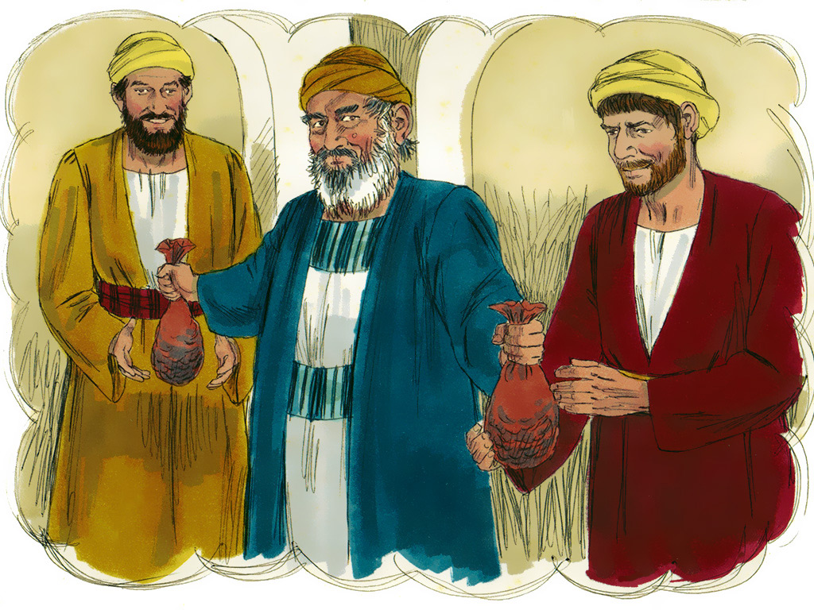
Making Choices Matt. 21:28-32

Slide 6
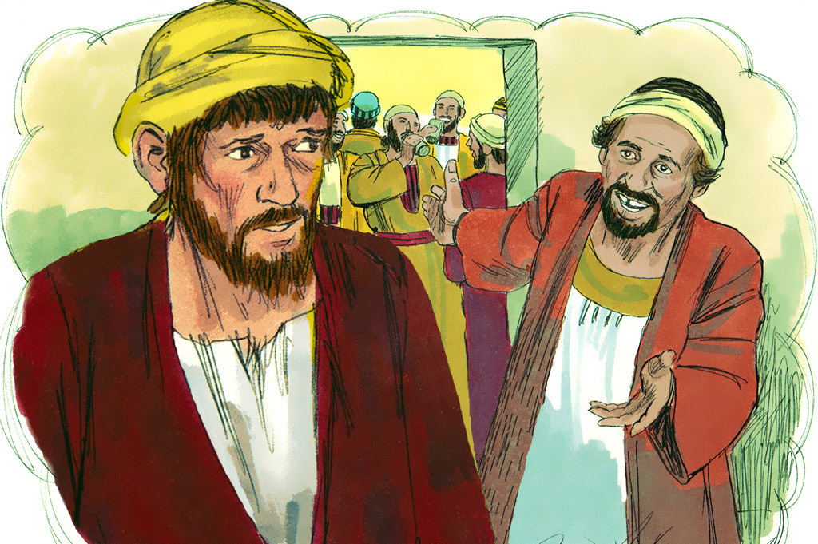

Slide 7
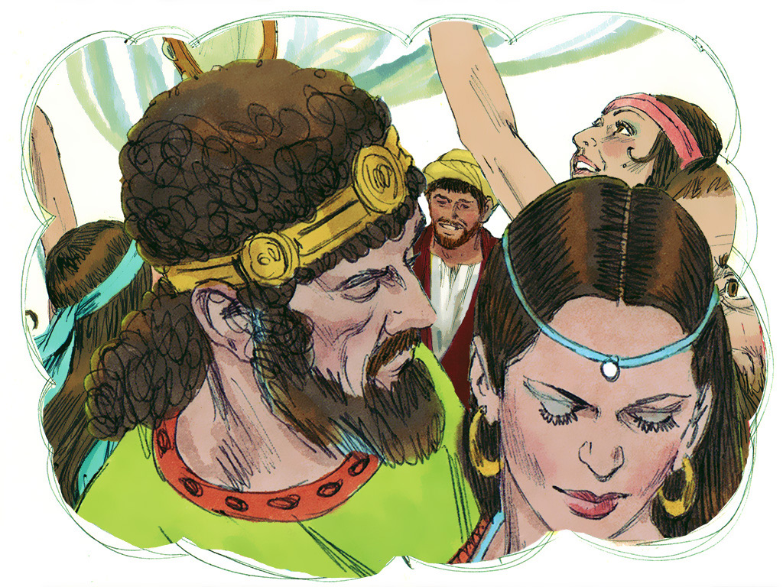

Slide 8
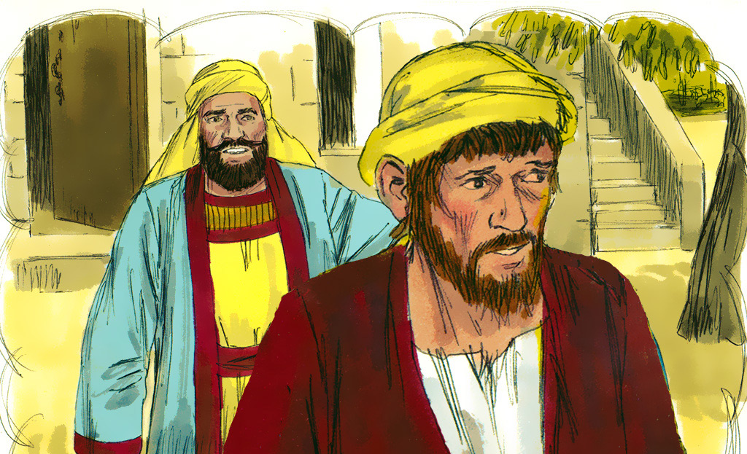

Slide 10
Let us pray together

Slide 11
Time to say bye bye have a wonderful week….

