Slide 1
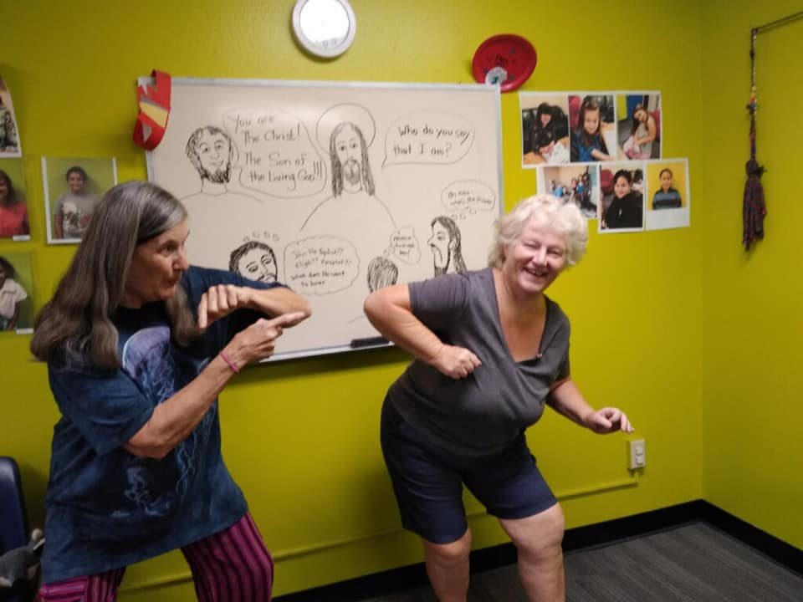
Hello Son Shine Club!!!

Slide 2
Introduction
Jesus taught us that if we wanted God to Forgive us, then we must learn to Forgive each other.
In today’s Gospel, he tells a parable about a Forgiving King and his unForgiving servant

Slide 3
Light the Candles

Slide 4
Matthew 18:23-35

Slide 5
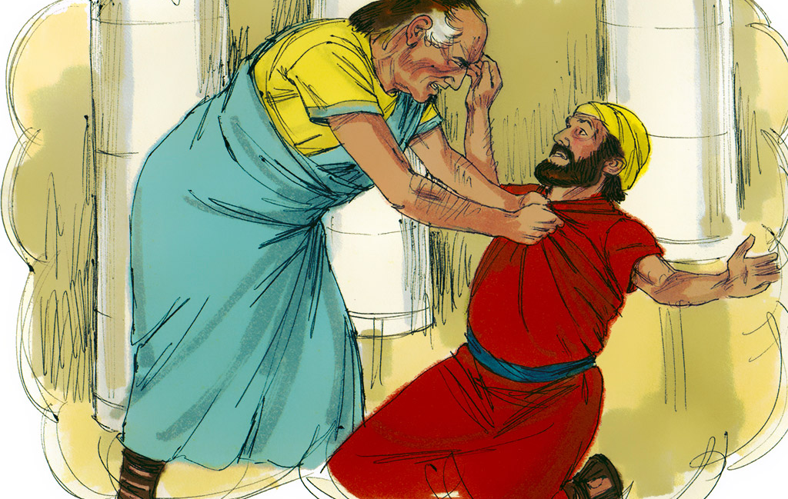

Slide 6
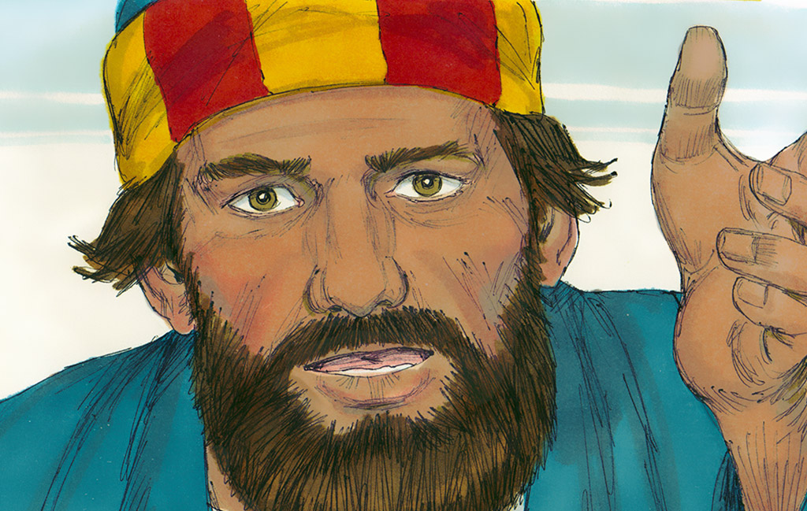

Slide 7
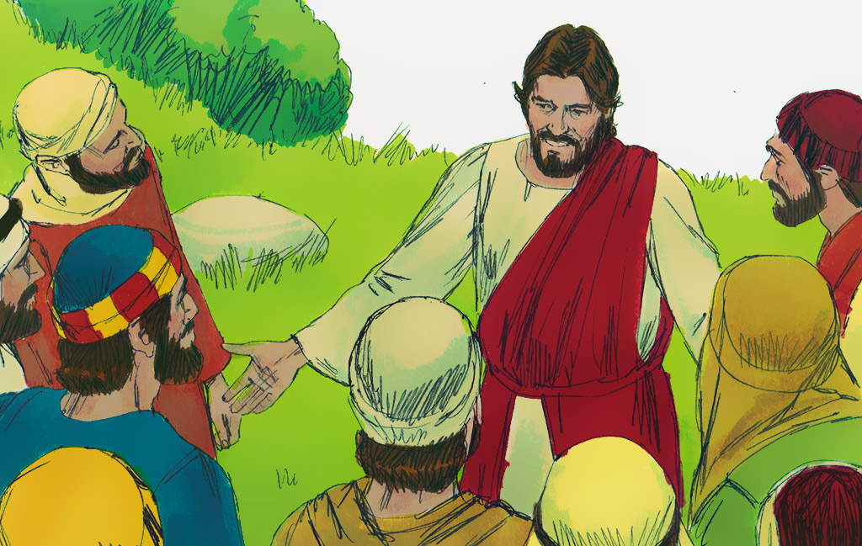

Slide 8
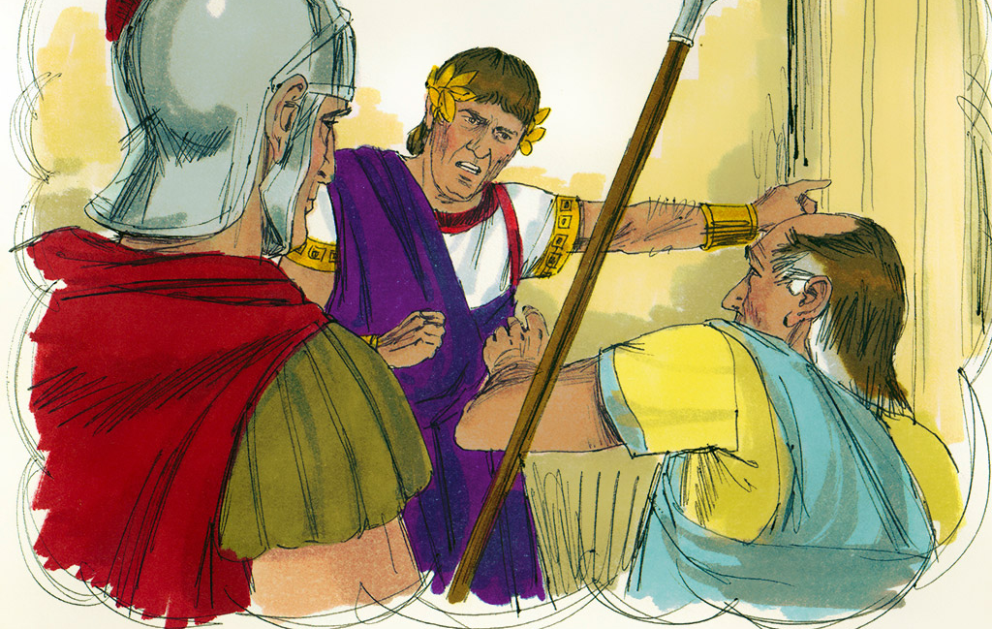

Slide 9
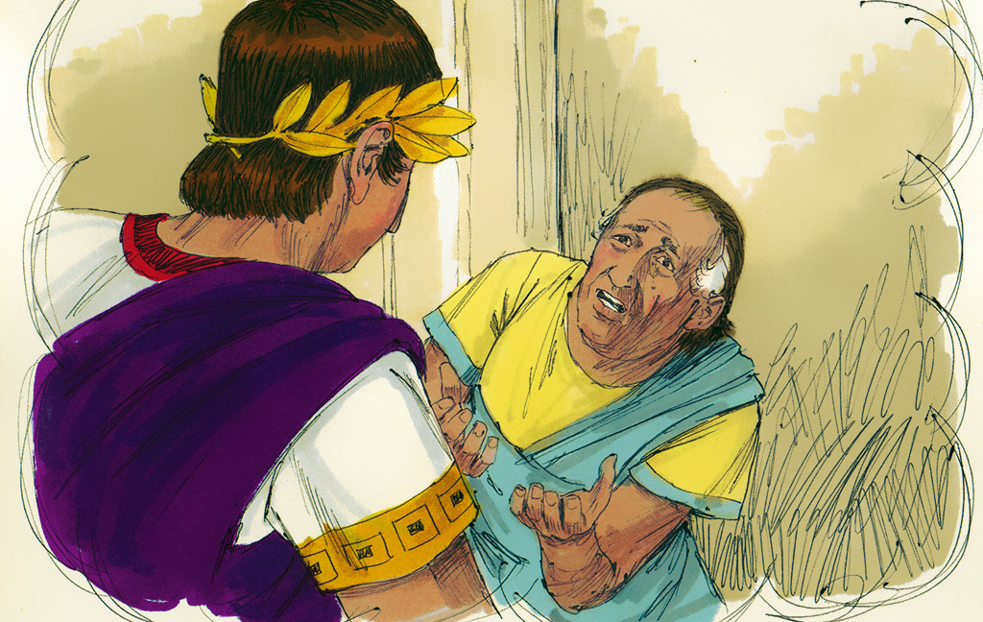

Slide 10
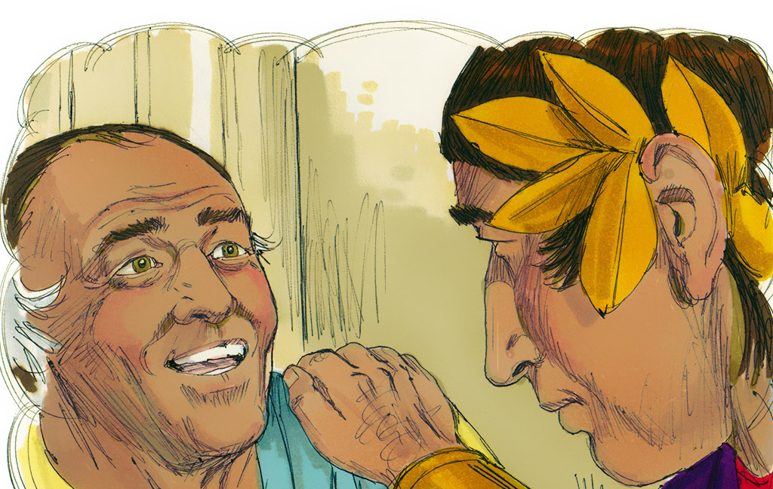

Slide 11
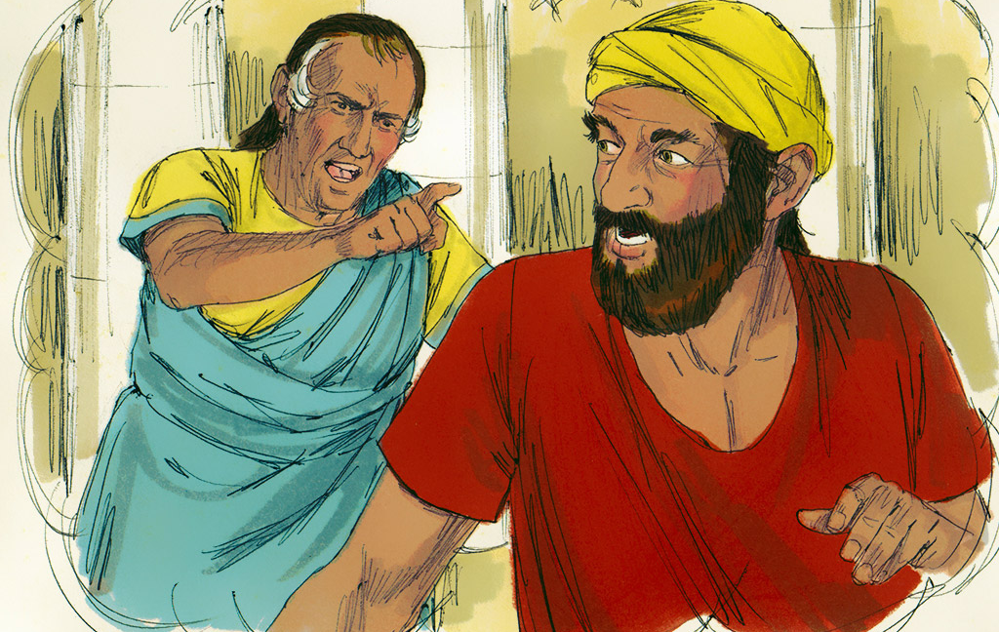

Slide 12
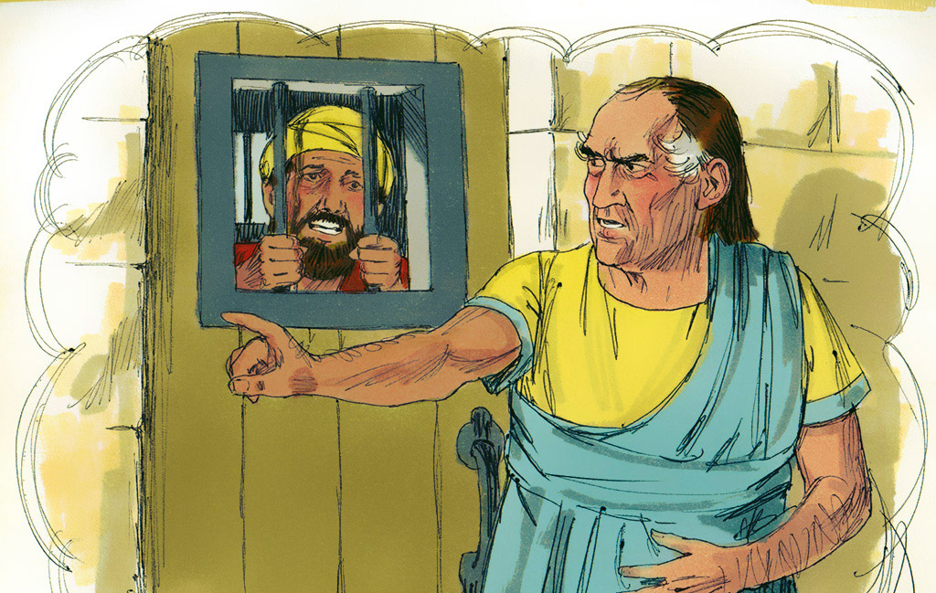

Slide 13
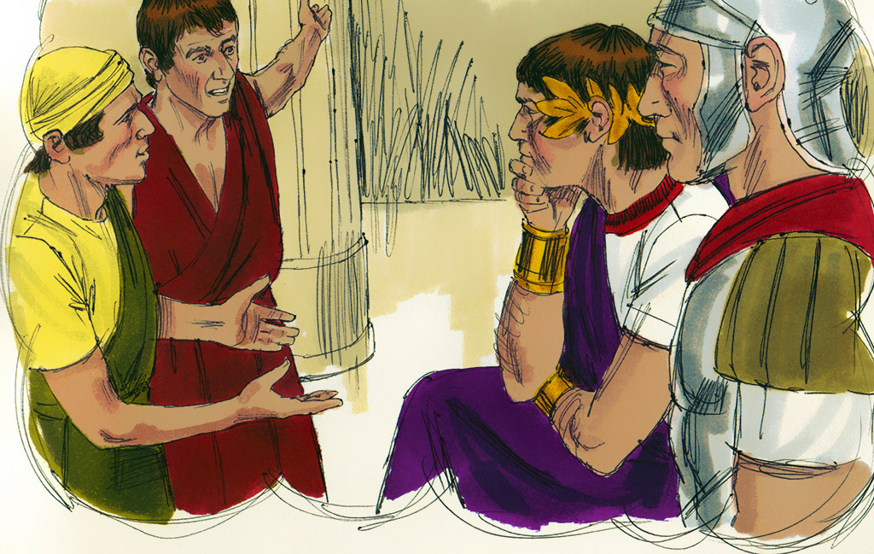

Slide 14
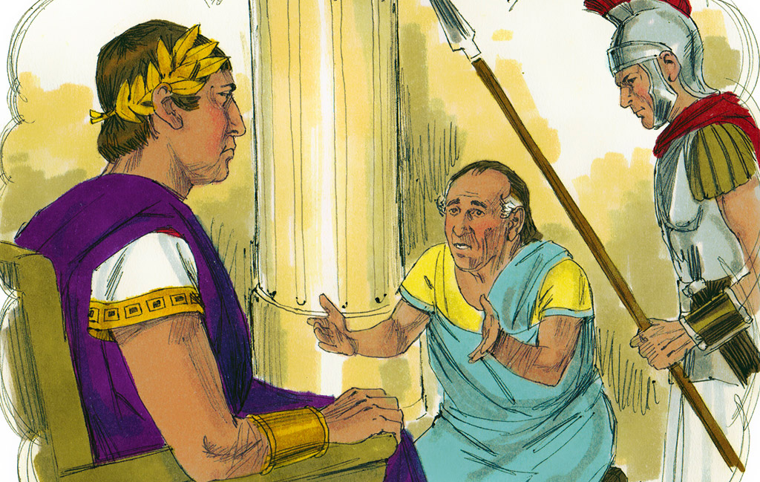

Slide 15
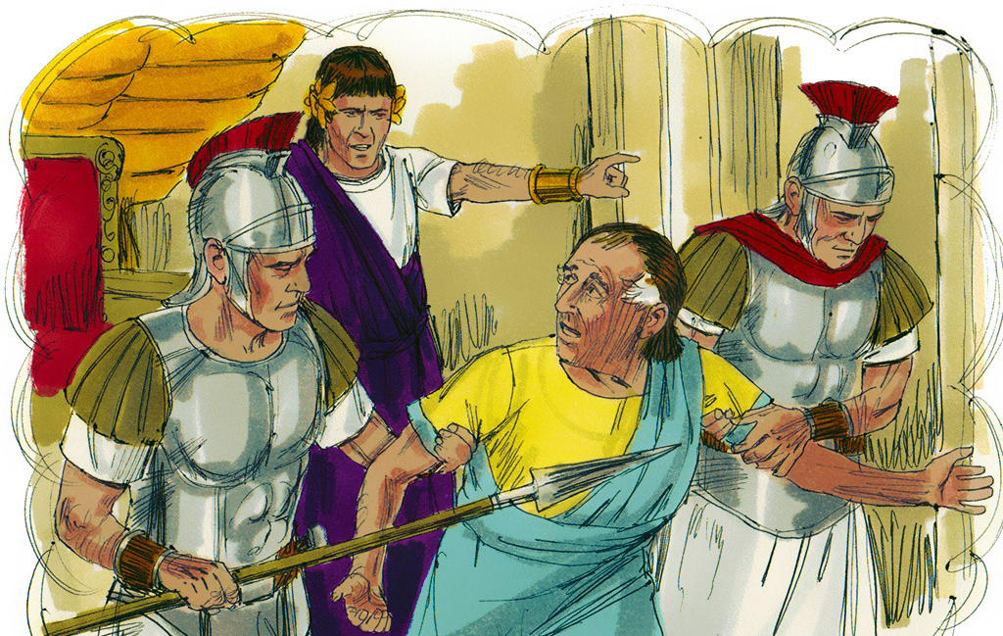

Slide 16
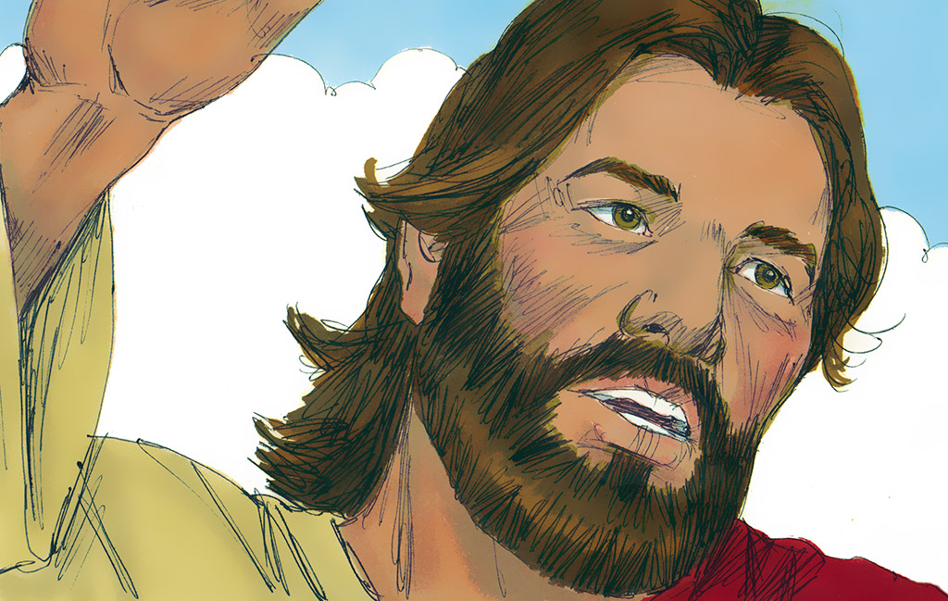

Slide 17
Reflections
When Peter spoke to Jesus about forgiveness, how many times did he suggest a person might be forgiven?
How do you think Peter felt when he heard Jesus reply?
Why was the King so angry with the servant he had earlier forgiven?
What does this story teach us about forgiveness?

Slide 18
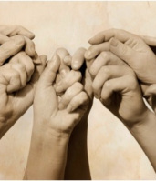
Let us pray togerther
by Unknown Author

Slide 19
Time to say goodbye!

